Slide 1


Slide 2
Market Research
To get customers to buy your product or service, you must know what they want.
Market research attempts to gather information about consumers’ perceptions and attitudes.
You can then use the information to design your product/service that meet customers’ needs, and to design marketing campaigns that communicate to them.

Slide 3
Market Research is used to:
  Provide data about customers, products, services, prices, location, what promotions to use, etc.
  Help project future sales
  Tell entrepreneurs what products or services are in demand
  Help the Entrepreneur refine and adapt their products or services
  Provide information on how your competitors are doing
Sleeping bag coats for the homeless
Ted talk on Sleeping Bag Coat

Slide 4
Research can be Qualitative or Quantitative
Quantitative – based on numbers – 56% of 21-year olds drink alcohol at least four times a week - doesn’t tell you why, when, how
Qualitative – more detail – tells you why, when and how! Touchy feely

Slide 5
Example of Quantitative Market Research Results for fast food chains
Results in %’s | Brand A | Brand B | Brand C | Brand D
Lots of locations | 5 | 15 | 50 | 30
Good menu range | 70 | 50 | 20 | 10
I like their food | 65 | 50 | 30 | 10
Great value | 20 | 30 | 50 | 30
I eat there weekly or more | 15 | 10 | 30 | 10
Never go there | 25 | 10 | 40 | 10
Good corporate citizen | 10 | 20 | 70 | 10
My preferred choice | 50 | 20 | 20 | 10

Slide 6

Types of Research: Primary & Secondary
Primary Research – gathering data firsthand
Conducted by you or by a company that you pay to conduct the research for you.
Downside- it can be expensive
  Methods:
    Observation
    Interviews
    Surveys
    Focus groups)

Slide 7
Surveys
Surveys involve asking a series of questions to a sample of the target population that is large enough to be statistically valid.
Surveys generally offer primarily closed-ended questions, although some open-ended questions may be included. Closed ended: Yes/No; Agree/Disagree; or “Rate on a scale of 1 to 10. (Quantitative)
Open ended: What do you like most about this flavour? (Qualitative)
Surveys can be administered by mail, telephone, email, Internet or in person.

Slide 8
Best Use of Surveys
Develop a profile of your users:
Identify client segments
Determine client characteristics
Validate or prioritize customer needs
Assess client satisfaction
Gauge customer awareness:
General awareness about your business
Post-advertising campaign awareness
Track changes in attitudes and opinions

Slide 9

Focus Groups
Focus groups are moderated group interviews and brainstorming sessions that provide information on users' needs and behaviors.
Focus groups can be useful for the following types of discussions:
Exploratory — Obtain information on general attitudes, understand the circumstances under which customers might require your product or service (triggers), understand their desired outcomes, and so on.
Comparative Analysis — Understand where else customers go to get similar information, services or products and what attracts them to those sources.
Trend Explanation — If you notice a trend in the way that customers use your website (for example, they always use the search function rather than navigating through the structured product list), then focus groups can be used to better understand why this is happening.

Slide 10
Personal Interviews
Personal interviews are semi-structured discussions with an individual. They include open-ended questions where the interviewer can probe further to understand underlying perceptions and behaviors.
Personal interviews are a more expensive alternative to focus groups and are generally used in the following situations:
The topic is too personal or sensitive to be discussed in a group, or confidentiality of the participant is required.
A person's opinion may easily be influenced by others in the group.
It is as important to learn as much about what people don't know about a subject, as what they do know. In a group setting, knowledgeable participants may inhibit less knowledgeable ones from participating.
Logistic problems may make groups impractical. For example, if participants are geographically dispersed, travel time and costs may be prohibitive.

Slide 11
Secondary Research
  Research – using data gathered by others (government agencies, chambers of commerce, trade associations etc)
  Downside – research that is not customized to your needs, so it may not be as useful as primary market research.
  www.canadabusiness.ca
  www.teamfredericton.com BIZPAL
  Google Trends
  Mintel Global New Products Database

Slide 12
For your venture plan you need to include
  Customer Profile (Target Market)
  Analysis of the Competition
  SWOT Analysis

Slide 13
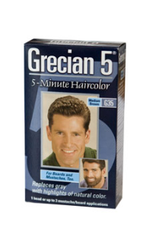
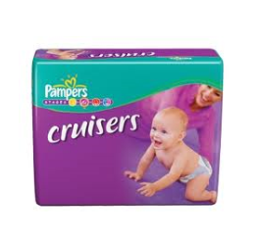

Customer Profile
It is important to know who will be buying your product or service; this is your “target market”
A target market is a group of customers that the business has decided to aim its marketing efforts and ultimately its merchandise towards.
Who is the target market for the following products/services?

Slide 14
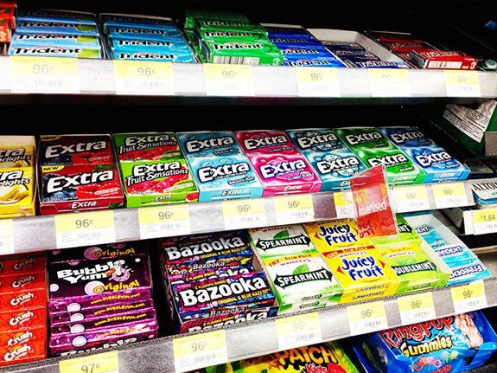
Importance of Target Markets
No single product will meet everyone’s needs
More than 30 different flavours/ varieties
How do you choose what type of gum to buy?
Ads?

Slide 15

Market Segmentation
Markets can be grouped into smaller subgroups this is known as Market Segmentation
The key is to find one or more ways of classifying or grouping users or potential users that really matter in terms of reaching them and satisfying their needs.

Slide 16
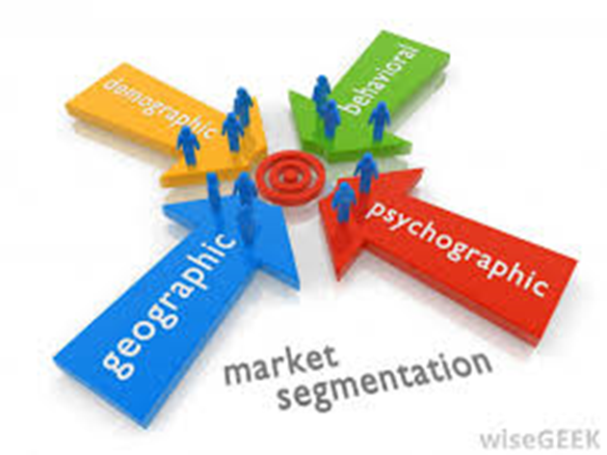
You should know the following things about your customers
Geographics:
  Where do your customers live; city, town, urban or rural.
Demographics :
  The personal characteristics of your target market; age, gender, family size, income, occupation, education, race, nationality, etc.
  How many are there? Use statistics when possible.
Psychographics:
What makes them tick? What are their likes, dislikes, values, opinions, beliefs, motivations, attitudes, and interests
Buying Characteristics:
Why and how often will they buy your product/service?

Slide 17
If you are selling skateboards who would be your customer?
Create a market segment profile for a 3-on-3 Basketball Tournament to take place at a local basketball court.

Slide 18
Answer
Males and females, ages 16-25, athletic and enjoys basketball, from the local community, has participated in recreational league, or camps for basketball

Slide 19
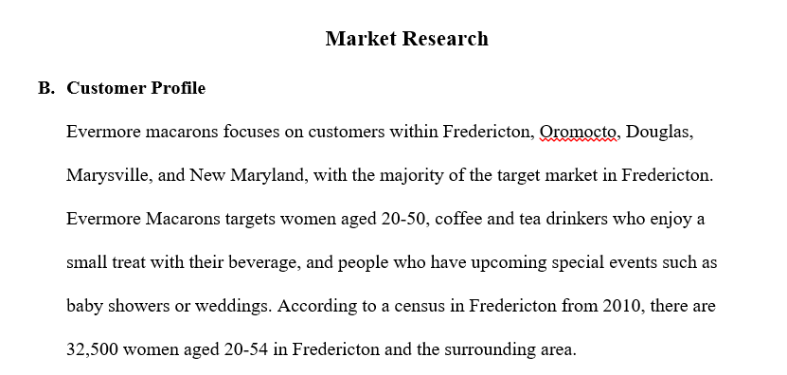
Example of a Customer Profile

Slide 20
Customer Profile
Your Town Assignment
Study the information provided for the fictional town (“Your town”) that you have been given.
Create a “customer profile” for this town. That is, how would you describe this town according to male vs. female population, income, education and occupation, etc.
What are two examples of ventures that would be successful in this town? Explain your decisions using the information in the chart.
What are two examples of ventures that would not be successful in this town? Explain your decisions using the information in the chart.

Slide 21
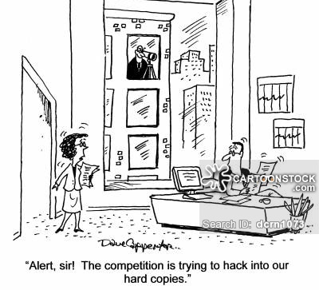
Competitive Analysis

Slide 22
The Purpose of the Competitive Analysis
It can uncover new business opportunities by pinpointing where customer needs are not yet being met.
It explains the market positions of a company’s direct and indirect competitors.
  Direct Competitors – Offer similar products (e.g. You want to buy a chocolate bar, all chocolate bars on the market are direct competitors)
  Indirect Competitors – Offer close substitutes that meet the same basic need (a bag of chips or some other snack that costs the same as the bar)

Slide 23
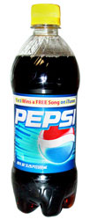

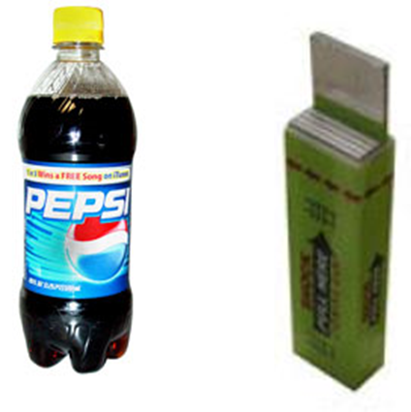
Direct Competition - Products that are similar.
Indirect Competition – all the other products that you could buy for the price of a bottle of water, e.g. a chocolate bar
Direct
Indirect

Slide 24
Competitive Analysis
You must identify your top direct competitor and your top indirect competitor
State the locations of your top competitors and the number of years in business.
Describe the primary markets or market segments that your competitors serve.
Describe what they offer your target market and any overwhelming strengths and weaknesses they have
Explain what you will do better

Slide 25
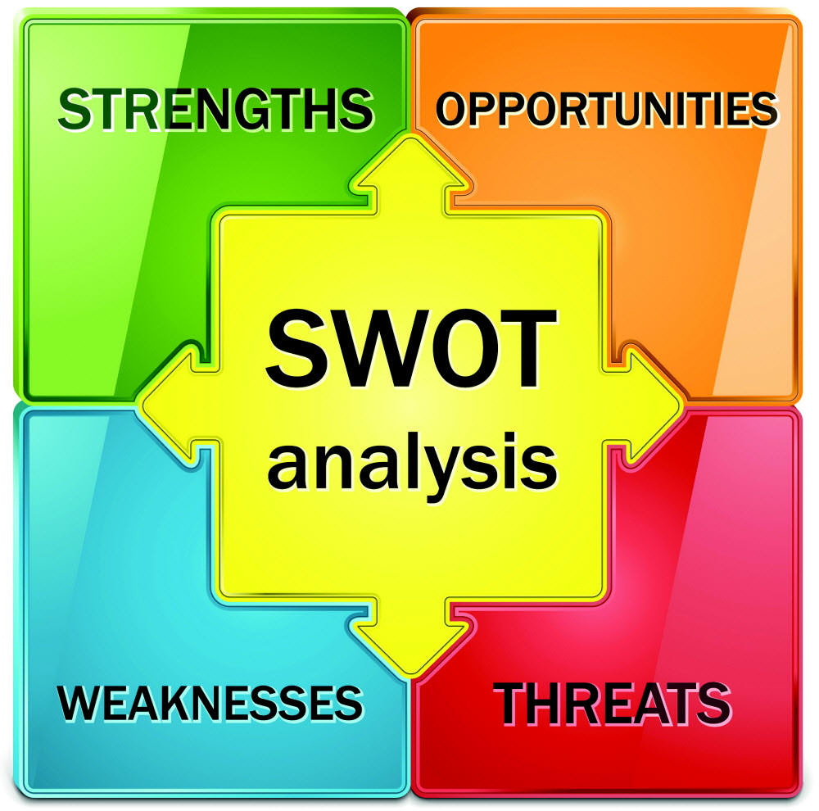
SWOT Analysis
You must complete a SWOT analysis for your own company

Slide 26
Strengths & Weaknesses
In SWOT, strengths and weaknesses are internal factors. For example: A strength could be:
your specialist marketing expertise.
a new, innovative product or service
location of your business
quality processes and procedures
any other aspect of your business that adds value to your product or service.

Slide 27
Strengths & Weaknesses
A weakness could be:
lack of marketing expertise
undifferentiated (common) products or services (i.e. in relation to your competitors)
location of your business
poor quality goods or services
damaged reputation

Slide 28
Opportunities& Threats
Opportunities and threats are external factors. For example: An opportunity could be:
a developing market such as the Internet.
mergers, joint ventures or strategic alliances
moving into new market segments that offer improved profits
a new international market
a market vacated by an ineffective competitor

Slide 29
Opportunities& Threats
A threat could be:
a new competitor in your home market
price wars with competitors
a competitor has a new, innovative product or service
competitors have superior access to channels of distribution
taxation is introduced on your product or service

Slide 30
Opportunities& Threats
Threat: What is the law???
There are laws but then there are also by-laws
What are the laws surrounding food trucks?
What are the laws surrounding food handling?
Businesses that involve animals?
  Old Quebec: no more horse drawn buggies
Jones Soda Case

